Slide 1
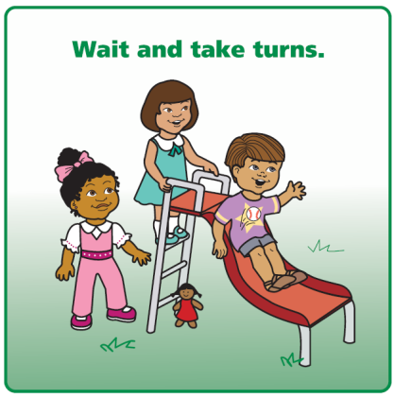
2 X 2 SOLUTION KIT CUE CARDS

Slide 2
3 X 3 SOLUTION KIT CUE CARDS

Slide 3
3 X 3 SOLUTION KIT CUE CARDS

